Slide 1
Panel 2 – Sharing data, collaborating and coordinating across the continuum of care
COCIR Digital Health Roadmap
Joost Felix
COCIR Lead member in Digital Health and Global Head Integrated Care Solutions at Agfa HealthCare

Slide 2
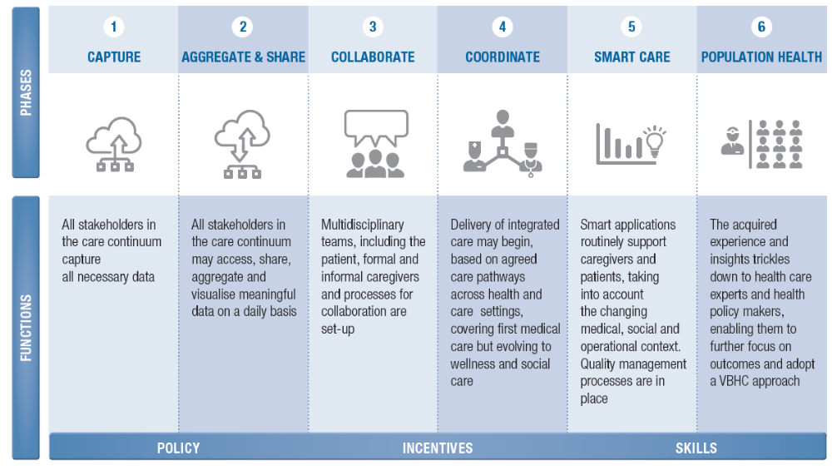
DIGITAL HEALTH ROADMAP
TO SUPPORT INTEGRATED CARE

Slide 3
DIGITAL HEALTH ROADMAP
- CHALLENGES
Technology
  Information silo’s
    HealthCare
    Social Care
    mHealth / app’s
  Cross domain interoperability
    Consumer
    Healthcare
    Social Care
  Normalization of data
  Lack of shared multi-domain process definition
Other
  Funding and reimbursement
  Data Ownership, Secondary Use and Machine Learning
  Regulations and guidelines versus innovation
  Change leaders and change management
  One size fits none
  …

Slide 4
DIGITAL HEALTH ROADMAP
- ROLE OF INDUSTRY
Cross industry knowledge sharing
Industry wide collaboration
  Inter operability
  Standardization
  Participate in public debate
Assist in scaling up
  Many industrial parties have experience w/ scaling up
Innovate, productize & roll-out
  and start again
Create economic growth

Slide 5
Thank you for your attention!
www.cocir.org

